Slide 1
Week 4 Synchronous Session

Slide 2
Agenda
Key reminders!
Week 3 Review – Quiz, Lessons, In-Module Exercises
Week 2 Homework Solution
Discussion time!
Mini lesson on multidimensional data
Looking ahead at Week 4

Slide 3
Reminders
Please review feedback + solutions, esp for Assignments + In-Module Exercises
Office hours 1-2 PM on Wednesdays or by appointment – easy link on Moodle where you can automatically sign up for a meeting with me! Please utilize!
DeCaria textbook for this class is handy, but as mentioned first week, up to you, and give you equivalent readings in open-source textbooks as much as possible
Please have Slack notifications turned on – I post intermediate updates, hints, etc. on Slack – easier and more interactive
Keep an eye out for your project plan worksheet – will be due Monday, Feb 21!

Slide 4
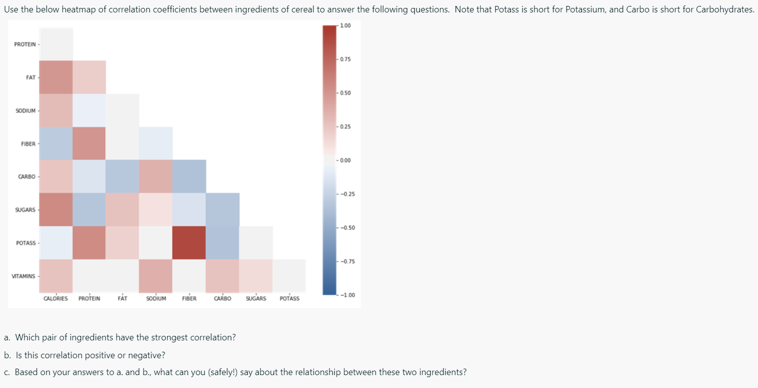
Week 3 Quiz
Week 3 Quiz
(c.) A positive relationship – as amount of fiber in cereal increases, amount of potassium tends to as well
Nothing about ‘causation though’ -> statistical relationship does NOT necessarily suggest a physical relationship!

Slide 5
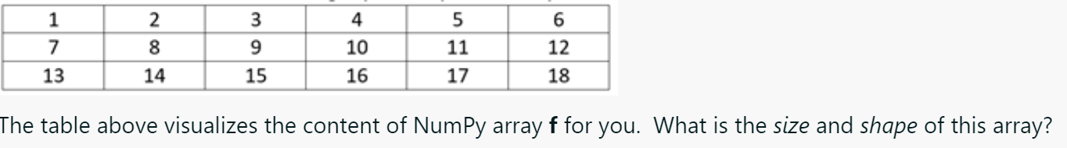
Week 3 Quiz
Key: distinction between size and shape

Slide 6
Week 2 Assignment
See my feedback to you, and solution/grading breakdown
Full credit for Q4 does not constitute approval of using that dataset for your project
Don’t forget key elements of plot:
Descriptive title
x and y-axis labels
Etc

Slide 7
Week 3 In-Module Exercises
See my feedback to you and solution
Careful when indexing!

Slide 8
It’s….discussion time!
What helps make a visualization clear, effective, and easy-to-interpret? Discuss specific examples if you have them, please! (Include links or one or two images) If time permits, discuss more subtle considerations!

Slide 9
Array operations over dimensions
second dimension: axis = 1
Example: wind speeds over central Illinois (gridded) - here, at the surface – array g
This is a 2D array of shape (2,4)
First dimension : axis = 0
10 | 9 | 11 | 7
13 | 12 | 10 | 9
10 | 9 | 11 | 7
13 | 12 | 10 | 9
(a.) np.mean(g,axis=0)
Physically: average over north-south
Collapsing dimension – “lose” the dimension
you specified you want to take the statistical
operation over!
11.5 | 10.5 | 10.5 | 8

Slide 10
Array operations over dimensions
second dimension: axis = 1
Example: wind speeds over central Illinois (gridded) - here, at the surface – array g
This is a 2D array of shape (2,4)
First dimension: axis = 0
10 | 9 | 11 | 7
13 | 12 | 10 | 9
10 | 9 | 11 | 7
13 | 12 | 10 | 9
9.25
11
(a.) np.mean(g,axis=1)
Physically: average over east-west

Slide 11
Array operations over dimensions
second dimension axis = 1
Example: wind speeds over central Illinois (gridded) - here, at the surface – array g
This is a 2D array of shape (2,4)
First dimension : axis = 0
10 | 9 | 11 | 7
13 | 12 | 10 | 9
10 | 9 | 11 | 7
13 | 12 | 10 | 9
10.125
(a.) np.mean(g)
Physically: average over both dimensions since didn’t specify one! Collapsing all dimensions, end up with single value

Slide 12
Array operations over dimensions
second dimension axis = 1
First dimension : axis = 0
10 | 9 | 11 | 7
13 | 12 | 10 | 9

Slide 13
Array operations over dimensions
third dimension
axis =2 (coming out of page)
second dimension axis = 1
Example: wind speeds over central Illinois (gridded) - here, at the surface and 1 km above surface– array g
This is a 3D array of shape (2,4,2) – the third dimension (axis = 2) is height!
First dimension : axis = 0
10 | 9 | 11 | 7
13 | 12 | 10 | 9
11 | 11 | 12.5 | 8
14 | 12 | 12 | 13
10.5 | 10 | 11.75 | 7.5
13.5 | 12 | 11 | 11
(a.) np.mean(g,axis =2)
This is the average, at each location, of the surface winds + the winds at 1 km above the surface
10 | 9 | 11 | 7
13 | 12 | 10 | 9
11 | 11 | 12.5 | 8
14 | 12 | 12 | 13
Physically: average over third dimension – height – result will be 2D array (2D grid) – “collapsing” the height dimension

Slide 14
Array operations over dimensions: logical
third dimension
axis =2 (coming out of page)
F | F | T | F
T | T | F | F
second dimension axis = 1
Winds at surface
First dimension : axis = 0
10 | 9 | 11 | 7
13 | 12 | 10 | 9
T | T | T | F
T | T | T | T
11 | 11 | 12.5 | 8
14 | 12 | 12 | 13
Winds 1 km above surface
(a.) How many wind speeds at each location are > 10?
np.sum(g>10,axis=2)
OR np.sum(np.where(g>10),axis=2)
This returns a Boolean array – True where condition is met, False where not met – this is a MASK
Key: True = 1, False = 0
It’s a 3D array of Trues/Falses – count up # of Trues along vertical axis (third axis; axis = 2) by SUMMING

Slide 15
Array operations over dimensions: logical
third dimension
axis =2 (coming out of page)
0 | 0 | 1 | 0
1 | 1 | 0 | 0
second dimension axis = 1
Winds at surface
First dimension : axis = 0
10 | 9 | 11 | 7
13 | 12 | 10 | 9
1 | 1 | 1 | 0
1 | 1 | 1 | 1
11 | 11 | 12.5 | 8
14 | 12 | 12 | 13
Winds 1 km above surface
(a.) How many wind speeds at each location are > 10?
np.sum(g>10,axis=2)
OR np.sum(np.where(g>10),axis=2)
This returns a Boolean array – True where condition is met, False where not met – this is a MASK
Key: True = 1, False = 0
It’s a 3D array of Trues/Falses – count up # of Trues along vertical axis (third axis; axis = 2) by SUMMING

Slide 16
Array operations over dimensions: logical
third dimension
axis =2 (coming out of page)
Winds at surface
F (0) | F (0) | T (1) | F (0)
T | T | F | F
Winds at surface
second dimension axis = 1
T (1) | T (1) | T (1) | F (0)
T (1) | T (1) | T (1) | T (1)
Winds 1 km above surface
First dimension : axis = 0
10 | 9 | 11 | 7
13 | 12 | 10 | 9
11 | 11 | 12.5 | 8
14 | 12 | 12 | 13
1 | 1 | 2 | 0
2 | 2 | 1 | 1
Result:
Summed # of True along the vertical axis (third dimension) at each location, so result is 2D array (of lat and lon dimensions). Why? We collapsed the third dimension by taking an aggregate operation over it
(a.) How many wind speeds at each location are > 10?
np.sum(g>10,axis=2)
OR np.sum(np.where(g>10),axis=2)
This returns a Boolean array – True where condition is met, False where not met – this is a MASK
Key: True = 1, False = 0
It’s a 3D array of Trues/Falses – count up # of Trues along vertical axis (third axis; axis = 2) by SUMMING

Slide 17
Looking ahead
Qs on Week 3 Homework?
What’s on tap for Week 4 – walkthrough video for longer overview
Remember, keep an eye out for Project Plan Worksheet (Milestone #1)

